Slide 1
CYCLISTIC BIKE SHARE ANALYSIS Primary goal of this project is to analyze users trip data of a bike sharing company to find differences between the behaviors of “casual riders" who pay for each ride and "annual members" who pay an yearly subscription fee for the service. Insights from this analysis will be useful for deciding whether to design a new marketing strategy to convert casual riders into annual members.
Key stakeholders
Marketing Analytics Team
Lily Moreno, Director of Marketing
Cyclistic executive team

Slide 2
Data source
Data Source
Data for this analysis has been made available by Motivate International Inc. under this license
For this analysis we only need data for the past 12 months
Data is credible as it is first party data collected by the company directly from its users
Business Objective: How do annual members and casual riders use Cyclistic bikes differently?

Slide 3
Steps for analysis:
We will use the following attributes to find out how annual members and casual riders use Cyclistic bikes differently.
How the number of rides compare for both type of user.
ride_length (We will see how the trip time differs for the two user type)
day_of_week (We will see what days are prefer by what type of user)
What times of the day are preferred by the two type of user.
start_station_name (We will see from which station annual members and casual riders start their trip most often)
start_station_name and end_station name (We will see which routes are used most by what type of user)

Slide 4
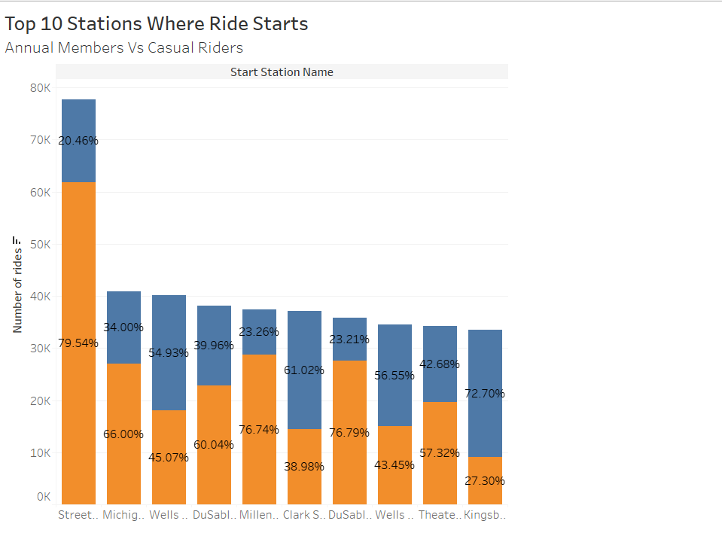

Slide 5
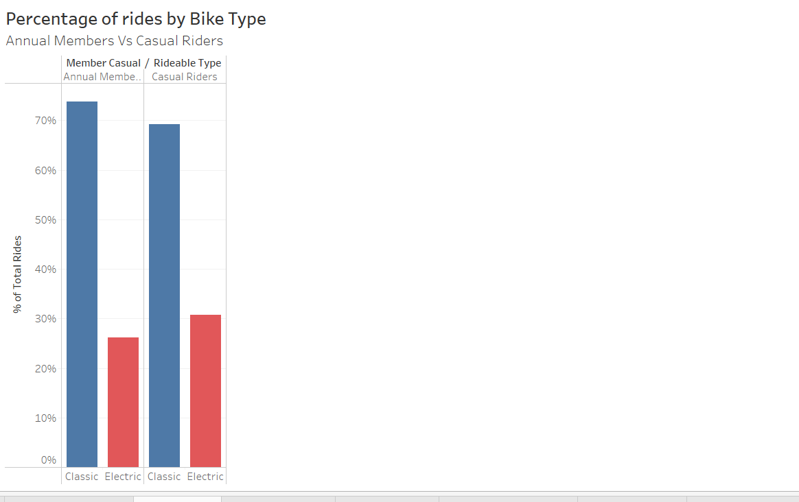

Slide 7
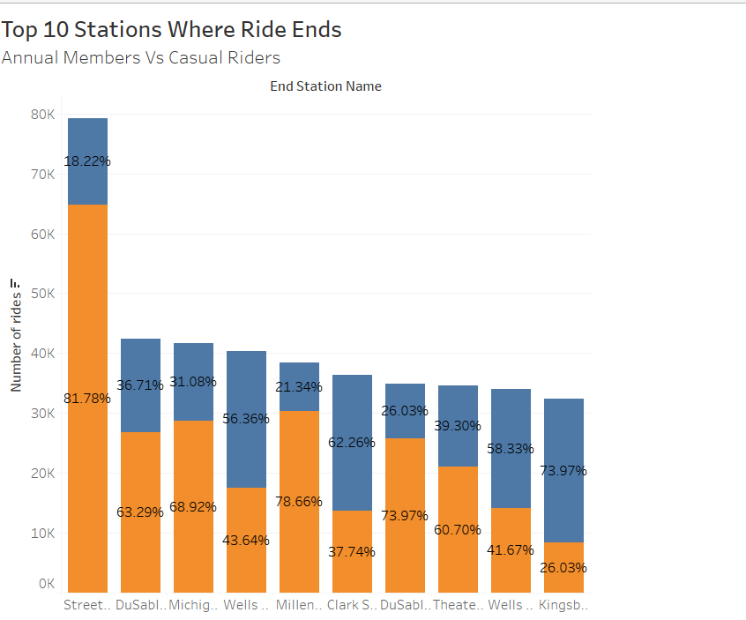

Slide 8
Conclusion:
Annual Members account for the majority of the rides with 56.73% of total rides coming from them, casual riders account for 43.27% of the rides.
Rides of casual riders are on average longer than Annual members. This is expected and in line with leisure oriented use by casual riders.
Although there is not a big difference, but casual riders prefer Electric bikes more than Annual Members. Availability of bike type can have an impact on this.
Streeter Dr & Grand Avenue is the most busy station, with around 80% of riders on this station are from casual riders. Beach and Museum around this location might be the reason for this.

